Slide 1
CSC 735 – Data Analytics
Chapter 2
A Gentle Introduction to Spark

Slide 2
Goal
Overview of Spark’s core architecture of a cluster
Overview of a Spark application
Overview of Spark’s structured APIs using DataFrames and SQL

Slide 3
Spark’s Basic Architecture
Using a single machine to process large data is not efficient
A cluster pools the resources of many machines together
We need a framework to coordinate work across these machines
Spark provides such a framework
it manages and coordinates the execution of tasks on data across a cluster of machines

Slide 4
Spark’s Basic Architecture (cont.)
A Spark application is submitted to a Spark cluster
The cluster manager takes care of allocating and coordinating resources on the cluster to run the application
Examples of cluster managers: Spark’s standalone cluster manager, YARN, or Mesos

Slide 5
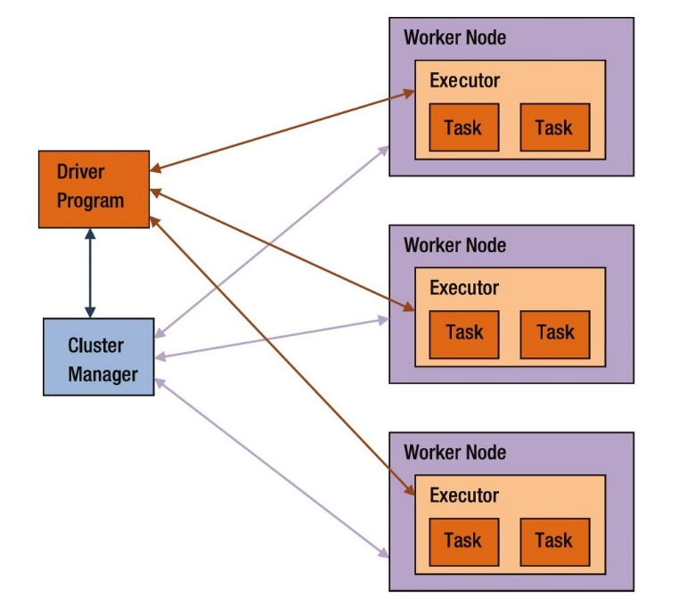
Spark Application
A Spark application involves five entities:
driver program
cluster manager
workers
executors
tasks

Slide 6
Workers
Nodes on the cluster
A worker provides CPU, memory, and storage resources
Application runs on workers

Slide 7
Cluster Manager
Spark uses a cluster manager to acquire and manage cluster resources to run an application
It enables multiple applications to share cluster resources and run on the same worker nodes

Slide 8
Driver Program
A Spark application consists of a driver program and a set of executors
Think of a driver program as the pilot of a plane
It contains the data processing code that Spark executes on the worker nodes

Slide 9
Driver Program (cont.)
It interacts with the resource manager and the executors
It is responsible for managing and distributing work across the executors
If the code requires the display of computed results to the user, the driver will collect the computed results from the executors and merge them together
It can run on a worker node on the cluster or on the client node that launched the application

Slide 10
Executers
Executors are JVM processes that Spark creates on worker nodes to run Spark applications
Each executor caches portion of the data in memory and/or disk
When a Spark application terminates, all the executors created for it also terminate
A node can have multiple executors

Slide 11
Tasks
A task is the smallest unit of work that driver sends to an executor
It is executed in an executor on a worker node
Each task performs some computations
Result can be sent back to driver
Spark creates a task per data partition
An executor runs one or more tasks concurrently

Slide 12
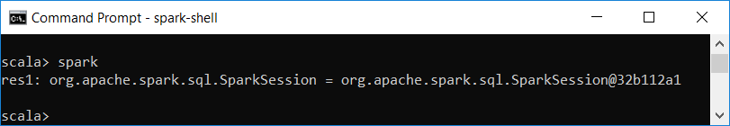
SparkSession
SparkSession is a Spark object that represents your entrance point to writing Spark code
It is the driver process of your Spark application
In interactive mode, a SparkSession object, named spark, is automatically created
There is a one-to-one correspondence between a SparkSession and a Spark Application

Slide 13
SparkSession
Creating a range of numbers
DF represents a distributed collection
DF is partitioned and stored on different executors
scala> val myRange = spark.range(1000).toDF("number")
myRange: org.apache.spark.sql.DataFrame = [number: bigint]

Slide 14
DataFrame
A DataFrame is a Structured API
It represents a table of data with rows and columns
A schema specifies the columns and their types
A DataFrame can span thousands of computers

Slide 15
Partitions
To allow parallelism, Spark breaks up the data into chunks called partitions
A partition is part of the data that sit on one computer
If you have one partition and many executors, Spark will have a parallelism of only one
If you have many partitions but only one executor, Spark will still have a parallelism of only one
When we write code, we do not manipulate the individual partitions

Slide 16
Transformations
The core data structures in Spark are immutable
Spark applications process data using methods that describe what needs to be done
These operations are called transformations

Slide 17
Transformations – Example
Apply a transformation to find all the even numbers in the DF myRange
Notice that no data will be output until we apply an action
scala> val divisBy2 = myRange.where("number % 2 = 0")
divisBy2: org.apache.spark.sql.Dataset[org.apache.spark.sql.Row] = [number: bigint]

Slide 18
Types of Transformations
There are two types of transformations:
narrow transformations
wide transformations

Slide 19
Narrow Transformations
where each input partition contributes to only one output partition
aka narrow dependencies
examples: previous where statement, filter
allow pipelining

Slide 20
Wide Transformations
where an input partition can contribute to more than one output partition
aka wide dependencies
examples: sort, groupByKey, join
aka shuffles
a shuffle requires data to be written on disk

Slide 21
Lazy Evaluation
Transformation operations are lazily evaluated
Spark will delay their evaluations until the last minute
Transformation specify a plan of operations to perform on the data
Lazy evaluation allows Spark to optimize the code
perform a filter early or combine many transformations into a single operation

Slide 22
Actions
An action is an operation that requires Spark to compute a result
An action operation triggers the computation of code
Actions are computed eagerly
Example:
divisBy2.count() // res3: Long = 500

Slide 23
Kinds of Actions
actions to view data in the console
myRange.show()
actions to collect data to native objects in the respective language
myRange.collect()
actions to write to output data sources

Slide 24
Spark Jobs
A job is a set of computations that Spark performs to return the results of an action to a driver program
An action triggers a job
A job is completed when a result is returned to a driver program
An application can launch one or more jobs

Slide 25
DF’s explain Method
prints the physical plan
let’s us see the DF’s lineage. i.e., how spark will execute the query to create the DF
useful for debugging
val flightData2015 = spark.read.csv("someFile.csv")
flightData2015.sort("count").explain()
== Physical Plan ==
*Sort [count#195 ASC NULLS FIRST], true, 0
+- Exchange rangepartitioning(count#195 ASC NULLS FIRST, 200)
+- *FileScan csv [DEST_COUNTRY_NAME#193,ORIGIN_COUNTRY_NAME#194,count#195] ...

Slide 26
Configuring Number of Partitions for a Shuffle
By default, Spark uses 200 partitions for a shuffle
The following code lets us change that:
Now, execute an explain plan
spark.conf.set("spark.sql.shuffle.partitions", "5")
flightData2015.sort("count").explain
*Sort [count#39 ASC NULLS FIRST], true, 0
+- Exchange rangepartitioning(count#39 ASC NULLS FIRST, 5)
+- *(1) FileScan csv [DEST_COUNTRY_NAME#37,ORIGIN_COUNTRY_NAME#38,count#39]

Slide 27
DataFrames and SQL
You can express your business logic using SQL or DFs
There is no performance difference
Both “compile” to the same underlying plan specified in the DataFrame code
Spark will run the same transformations either way

Slide 28
DataFrames and SQL (cont.)
To write SQL, you need to first register the DF as a table
Then, use the spark.sql function to write SQL code
flightData2015.createOrReplaceTempView("flight_data_2015")
val sqlWay = spark.sql("""
SELECT DEST_COUNTRY_NAME, count(1)
FROM flight_data_2015
GROUP BY DEST_COUNTRY_NAME
""")
sqlWay:org.apache.spark.sql.DataFrame = [DEST_COUNTRY_NAME: string, count(1): long]

Slide 29
DataFrames and SQL (cont.)
val dataFrameWay = flightData2015
.groupBy('DEST_COUNTRY_NAME)
.count()
dataFrameWay:org.apache.spark.sql.DataFrame = [DEST_COUNTRY_NAME: string, count: long]
sqlWay.explain
dataFrameWay.explain
== Physical Plan ==
*HashAggregate(keys=[DEST_COUNTRY_NAME#182], functions=[count(1)])
+- Exchange hashpartitioning(DEST_COUNTRY_NAME#182, 5)
+- *HashAggregate(keys=[DEST_COUNTRY_NAME#182], functions=[partial_count(1)])
+- *FileScan csv [DEST_COUNTRY_NAME#182] ...
== Physical Plan ==
*HashAggregate(keys=[DEST_COUNTRY_NAME#182], functions=[count(1)])
+- Exchange hashpartitioning(DEST_COUNTRY_NAME#182, 5)
+- *HashAggregate(keys=[DEST_COUNTRY_NAME#182], functions=[partial_count(1)])
+- *FileScan csv [DEST_COUNTRY_NAME#182] ...

Slide 30
Another Example
Use the max function, to find the maximum number of flights to and from any given location, over all locations
spark.sql("SELECT max(count) from flight_data_2015").take(1)
Array([370002]
import org.apache.spark.sql.functions.max
flightData2015.select(max("count")).take(1)
import org.apache.spark.sql.functions.max
Array([370002])

Slide 31
Example – Using Multiple Transformations
Find the top five destination countries in the data
val maxSql = spark.sql("""
SELECT DEST_COUNTRY_NAME, sum(count) as destination_total
FROM flight_data_2015
GROUP BY DEST_COUNTRY_NAME
ORDER BY sum(count) DESC
LIMIT 5
""")
maxSql.show()
maxSql:org.apache.spark.sql.DataFrame = [DEST_COUNTRY_NAME: string, destination_total: long]
+--------------------------------+--------------------+
|DEST_COUNTRY_NAME|destination_total |
+--------------------------------+--------------------+
| United States | 411352|
| Canada | 8399|
| Mexico | 7140|
| United Kingdom | 2025|
| Japan | 1548|
+---------------------------------+-------------------+

Slide 32
Using Multiple Transformations -- DataFrame Syntax
import org.apache.spark.sql.functions.desc
flightData2015
.groupBy("DEST_COUNTRY_NAME")
.sum("count")
.withColumnRenamed("sum(count)","destination_total")
.sort(desc("destination_total"))
.limit(5)
.show()
The entire DataFrame transformation flow

